Slide 1
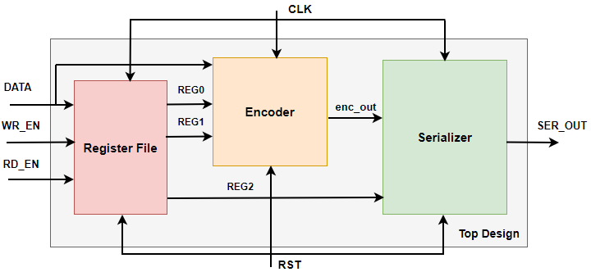
Write the Top Verilog Module
Structural Verilog is used to :-
1) Assemble several blocks together in a hierarchical design
Internal connections are of wire Type
© 2021 Eng. Ali Mohamed

